Slide 1
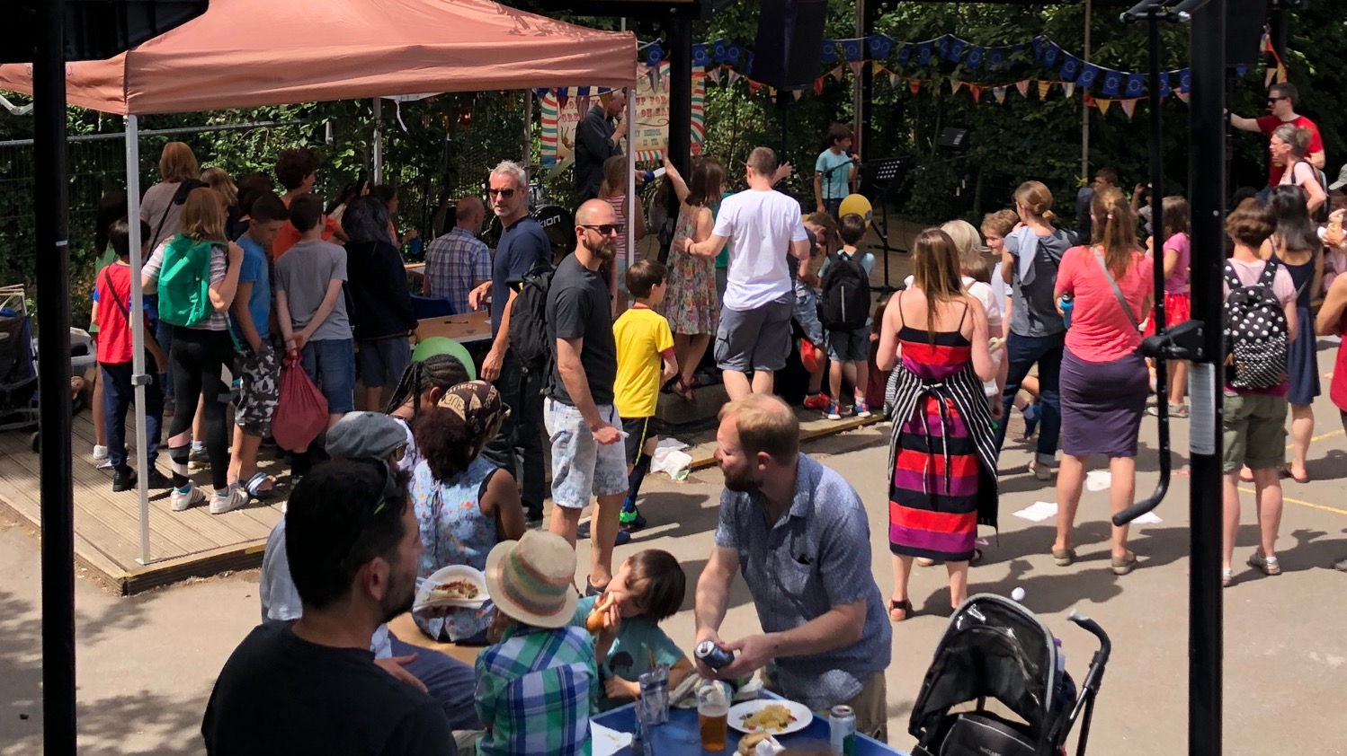
COLERIDGE FAMILIES
AGM 2019

Slide 2
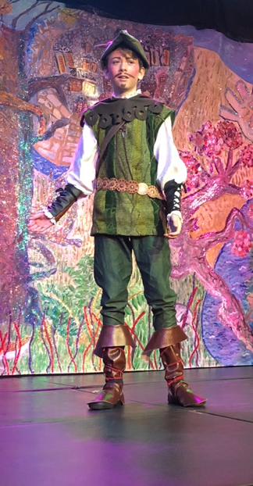
Welcome and Agenda
Introductions
Summary of the year : what, how, inclusion and projects we’ve funded
Accounts
Spending plans
Environmental issues
New events
Join us!

Slide 3
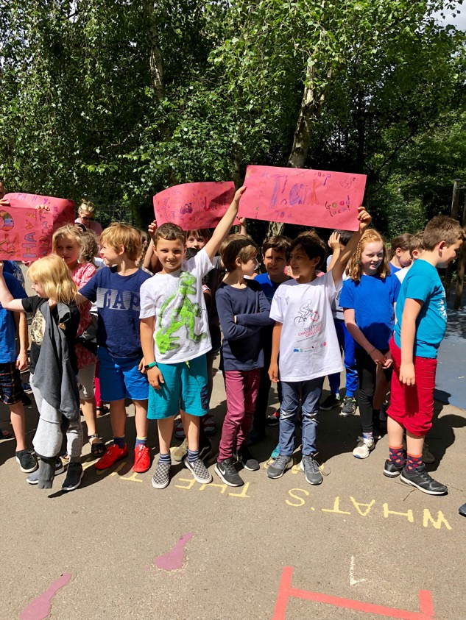
What is Coleridge Families?
Parent staff association and a registered charity
Partnership with School and Governors towards building a school community: involvement, participation and access
Fundraising: providing facilities which the local authority doesn't normally provide

Slide 4
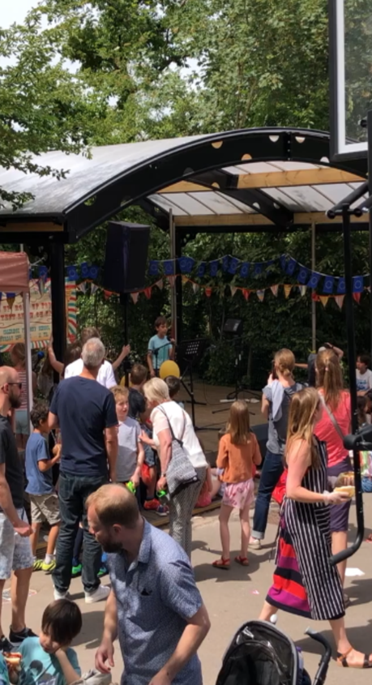
How did we raise money in 2018 / 2019?
Events
Year group events
Committee based events
Individual initiatives
Mixed events
Year group initiatives: Movie Night
Donations to LEF – purchases reviewed by committee termly to meet charity rules

Slide 5
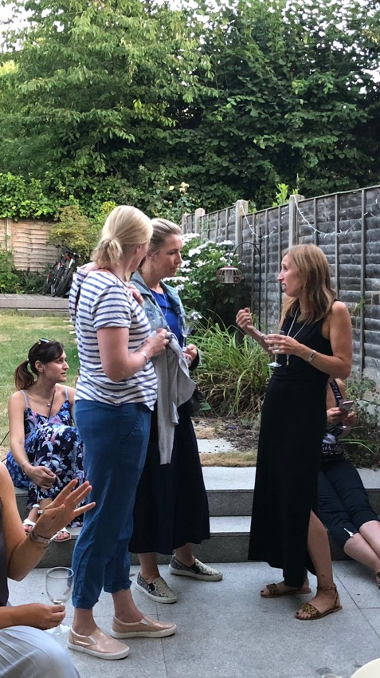
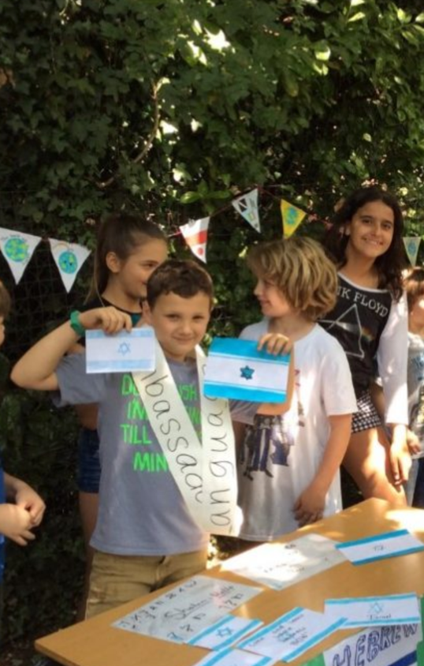
Inclusion and the reps network
New parents evening in June
New CF pages on the website and all events on the school online calendar
Reception and year group coffee mornings
Reps network is essential to inclusion and to the events
More initiatives on the cards – Cultures of Coleridge

Slide 6
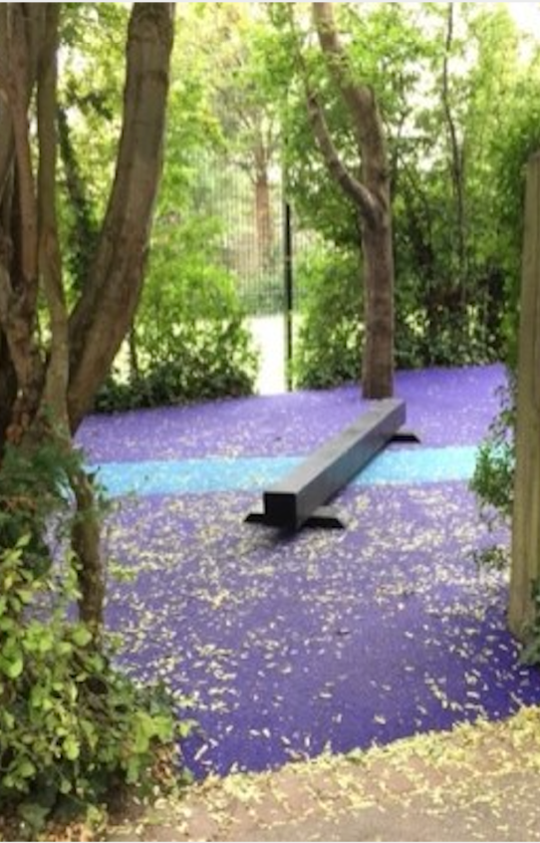
What have we funded in 18/19?
Playgrounds (more on this later)
Hall storage
Poetry workshop
Kids Concert Company
Books workshop at Ally Pally Book Awards
Library books
Water bottles
Gazebos

Slide 7
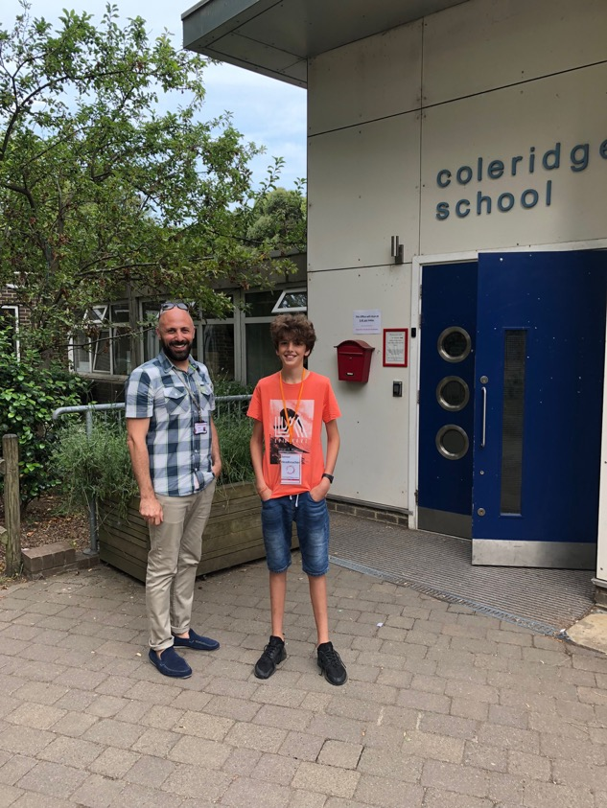
Accounts
Peter Salerno in the Treasury Team
Summary of income and expenses
Available funds
Approval of accounts

Slide 8
Coleridge Families Accounts – 30-Sep-19
Summary of Coleridge Families Accounts
# | Item | Amount |  | Comment
1 | Opening 1-Oct-18 | £87,700.74 |  | Total bank balances
2 | Fund Raising | £77,487.98 |  | Includes pending expenditures
3 | Expenditures | -£71,395.83 |  | includes pending expenditures
4 | Closing Balance | £93,792.89 |  | Closing 2019 Balance
5 | Bank Balance | £111,456.02 |  | Actual Bank Balance
6 | Variance | -£17,663.14 |  | See Detailed Section
7 | Capital Reserve | -£8,000.00 |  | Coleridge Families have agreed to keep an £8K reserve
8 | Approved Expenditures | £14,072.00 |  | See Detailed Section
8 | Remaining Available To Spend | £71,720.89 |  | Bank Balance, less committed expenses & reserve
Approved Major Expenditures
# | Description | Amount
1 | MUGA Replacement Fund | 10,000
2 | LEF Donations and Gift Aid | 4,072
3
4
5
6
7 | Grand Total | 14,072
Explanation of Variances
# | Description | Amount
1 | Playground invoice payable in October | -£14,690.00
2 | Invoice 40 paid in October | -£7,550.64
3 | Gift Aid yet to Receive | £4,579.50
5 | Grand Total | -17,661.14
Since Close of 2019, additional funds raised from T-Shirts and Donations raising the amount available to spend to 81,823.63. 2019 Fireworks display
Peter Salerno

Slide 9
2018-2019 CF Accounts – Income/Expense Detail
Income from Fund Raising Activities
Expenses from Projects Undertaken
Row Labels | 2017-2018 | 2018-2019
Summer Fair | 14,757 | 17,586
Donations - CF (Incl gift aid) |  | 20,000
Donations - LEF (Incl gift aid) | 31,896 | 4,072
Cycle Challenge and Gift Aid | 25,929
Year 6 Big Night Out (gig) | 2,380 | 1,234
Fireworks | 7,596 | 5,530
Sponsorship | 5,500 | 5,500
Quiz Night | 5,334 | 4,897
Clean Air Coleridge |  | 7,060
Winter Bazaar | 2,687 | 2,726
Silent Disco | 1,131 | 2,276
Year 6 School Play | 3,392 | 813
Sponsored Bounce | 1,139 | 1,377
T-Shirts | 1,094 | 956
Greeting Cards | 792 | 764
Halloween Disco | 1,485
Easyfundraising | 822 | 472
Year 6 Fundraising | 858 | 528
Year 6 Bobble Hats | 526
Yogathon | 838
Y2 Mud Race |  | 690
Planting Fundraiser | 623
Tickets4Schools | 585
Cake Sale | 559
Christmast Trees |  | 540
Movie Night |  | 453
Sports Day | 442
Christmas Trees | 384
Winter Bazaar Flash Sale | 144
Other | 71
Bank Interest | 7 | 13
Grand Total | 110,969 | 77,488
Row Labels | 2017-2018 | 2018-2019
Playground |  | 58,579
2018 Learning Enhancement | 25,010
2017 Learning Enhancement | 23,200
School Halls | 10,715 | 3,386
Year 6 Leavers | 4,292 | 3,853
Halls Storage | 4,342
Stage Supplies | 916 | 964
Reception Book Bags | 330 | 672
Children's SCRAP Project | 417 | 417
Reception Bookbags | 660
Water Bottles |  | 649
Playground Water Fountains | 625
Gazebos |  | 569
Year 1 Planting | 563
Holiday Parties | 393 | 121
Concert Afternoon |  | 429
Year 6 Poetry |  | 400
Beekeeping | 390
Ladders & Trolley |  | 382
General | 244
PTA Association | 117 | 117
Shelving |  | 187
Sports Teams Tshirts | 186
Platform |  | 175
Library Books | 89 | 105
Christmas Carols |  | 161
Christmas Carols Donation | 159
Coin Counter | 146
Storage Fund | 134
Coffee Morning | 58 | 63
Pyjama Karma |  | 62
Alexandra Palace Book Awards |  | 60
Dropbox |  | 44
Grand Total | 72,985 | 71,396
Year 6 Leavers Activities are supported by Year 6 fund raising events such as the Gig Night and Play sales shown as income (left hand side)
Peter Salerno

Slide 10
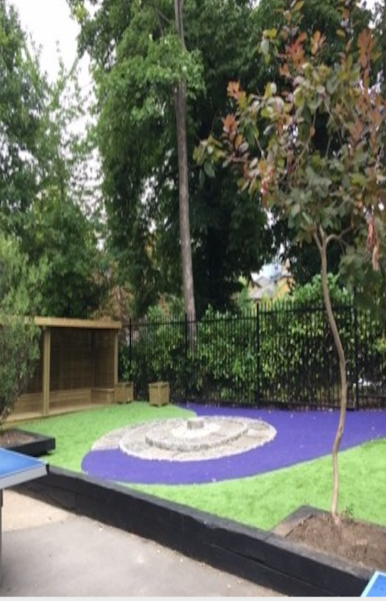
Plans for future spending
Playground renewal : £72k set aside c £65k spent so far
Tipping Point Project
New gate
Millennium garden
Wildlife area
Area outside year 4 door
Next stage: play house behind the climbing frame, allotment beds, the bank
Update from Mr Choueke

Slide 11
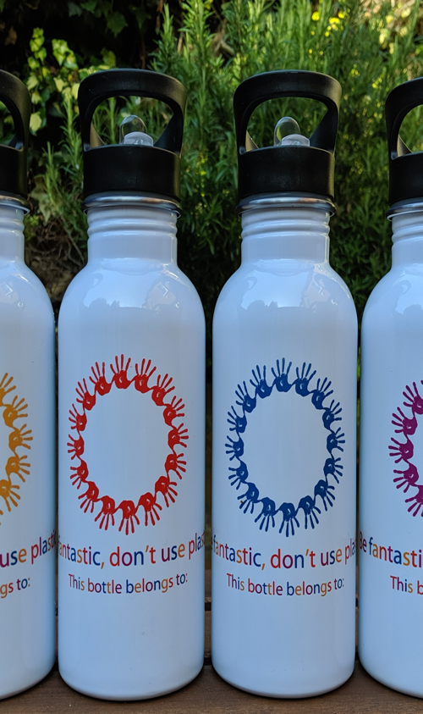
Environmental issues
Clean Air Coleridge – air pollution – green wall
Plastic Free Coleridge:
Water bottles
Coffee cups
Meat free Mondays
Sustainable events policy

Slide 12
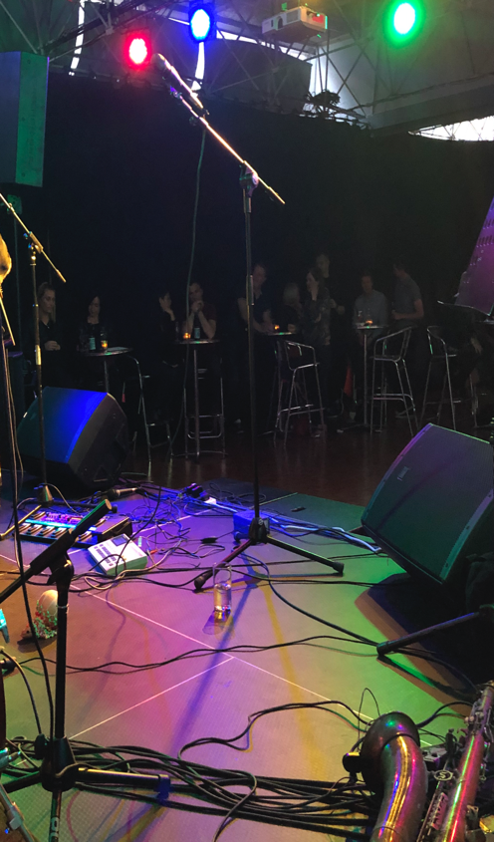
New events for 2020
An evening with Georgia’s dad (aka Steve Howe from Yes)
Comedy with the Scummy Mummies

Slide 13
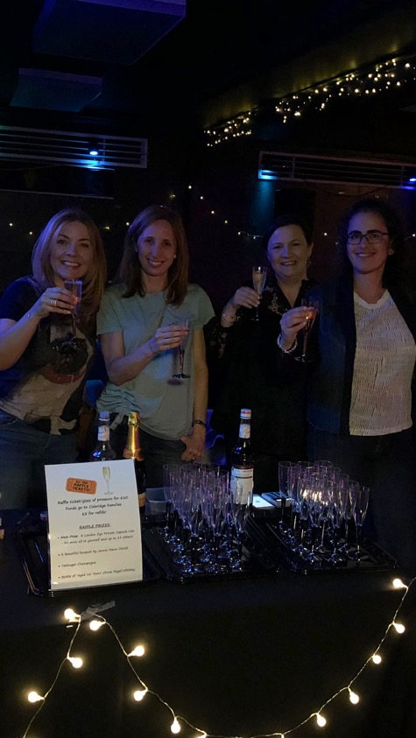
Join the Committee
We would love to have you!
We meet twice a term
Looking in particular for help on:
administration
managing events
keeping the community updated
day to day treasury functions
helping the rep network

Slide 14
Any other business?

